Slide 1
Sentiment Analysis Of Tweets
Statistical Machine Learning (CSE 575)
Group 6
Mentor: Prof. Yoojung Choi
The Team
Bhrugu Dave
Mohil Devan Khimani
Viranchi
Laksh Gangwani
Nilay Gandhi

Slide 2
Problem Statement
To classify a given tweet by a user into:
Positive - Negative sentiment
Depressed - Not Depressed sentiment
Left bias - Right bias political sentiment
using various machine learning classification models and comparing them with each other, along with some interesting analysis.

Slide 3
Motivation
Social Media is an inseparable part of modern society
We can analyse it for insight
It influences people's mental health, ideas and political opinions very easily
A lot of tech companies and governments are interested in analyzing behaviour of users

Slide 4
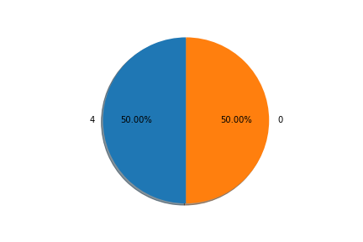
Positive - Negative Sentiment dataset
The sentiment140 dataset¹ which contains 1.6 million tweets extracted using the twitter API with labels 0 = negative & 4 = positive.
¹Go, A., Bhayani, R. and Huang, L., 2009. Twitter sentiment classification using distant supervision. CS224N Project Report, Stanford, 1(2009), p.12.

Slide 5
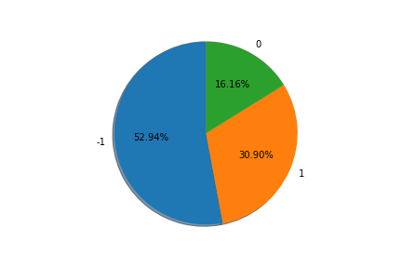
Depression Sentiment dataset
The depression dataset² which contains 3500 tweets. The tweets have the labels -1 = negative, 0 = neutral, 1 = positive and sentiment pertains to depression.
²https://github.com/AshwanthRamji/Depression-Sentiment-Analysis-with-Twitter-Data/

Slide 6
Political Sentiment dataset
For this, we have made our own dataset, for which a script has been written in snscrape scrapper module in python. This dataset was made by scraping the tweets with hashtags like #feminism, #equality, #socialjustice labeled as having Left Bias so they have being labeled as 0, while the ones with #rightwing, #conservative, #republican, #Trump as having more Right Bias so have the label as 1.

Slide 7
Methodology
Tweets contain a lot of puncuntations, mentions, and hashtags
These must be removed, and then all words must be tokenized and lemmatized
For feature extraction, we have used Bag-of-Words technique
And now we can feed this into our ML models

Slide 8
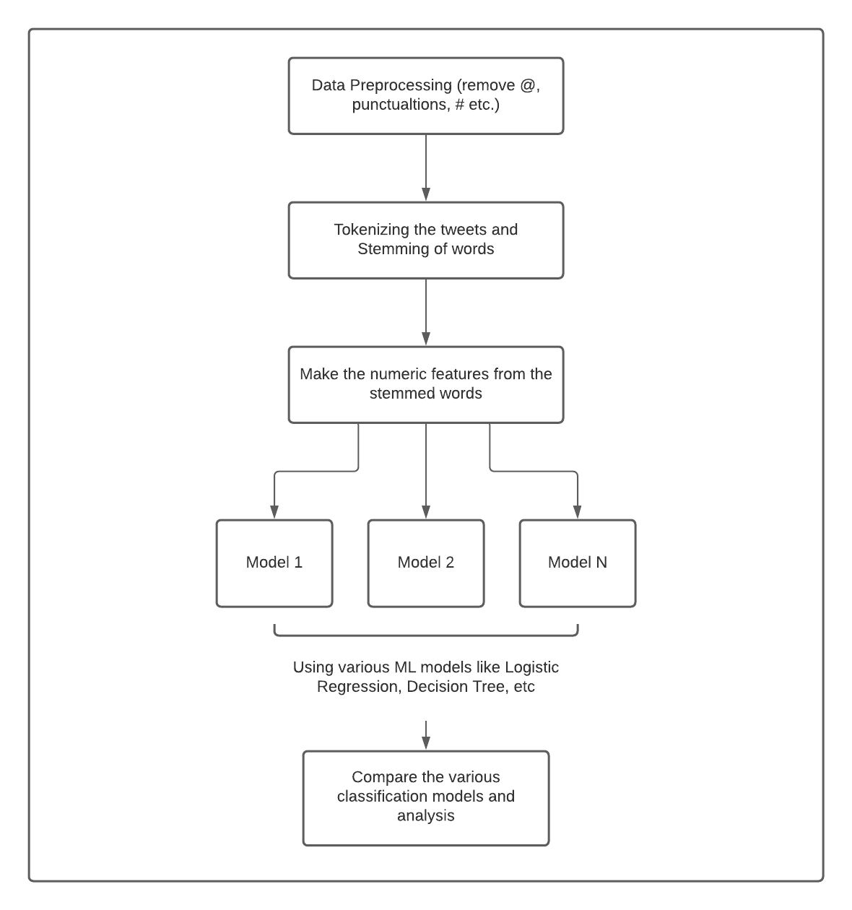
Experimental Flow

Slide 9
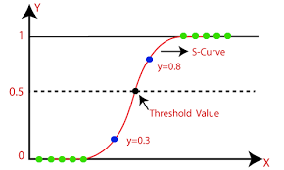
ML models used
Logistic Regression:

Slide 10
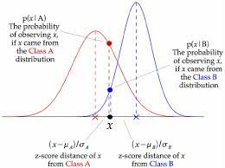
Gaussian Naive-Bayes Classifier

Slide 11
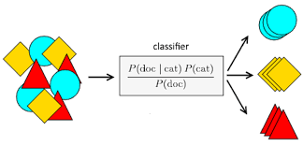
Multinomial Naive-Bayes Classifier

Slide 12
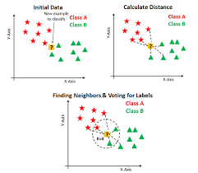
K-Neighbours Classifier

Slide 13
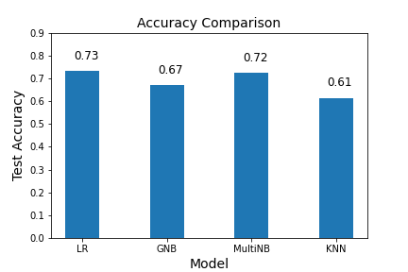
Positive - Negative Sentiment dataset

Slide 14
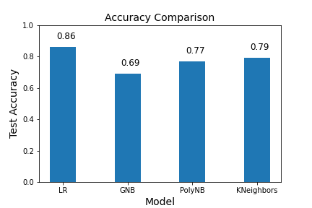
Depression Sentiment dataset

Slide 15
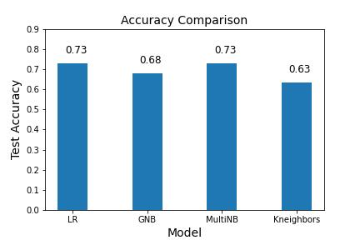
Political Sentiment dataset

Slide 16
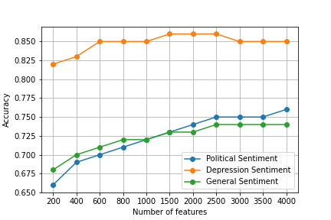
Effect of Number of Features on Accuracy

Slide 17
Conclusion
We present sentiment analysis of tweets for 3 categories of sentiments through use of open-source and also self-generated datasets.
We also perform processing of datasets prior to use for our classification models for filtering various unnecessary components of tweets.
We find applicability of Logistic Regression and Multinomial Naive Bayes Classifier for all three datasets with the best accuracy across all tested models.
We also discussed the effect that number of retained features has on the accuracy of models.

